Slide 1
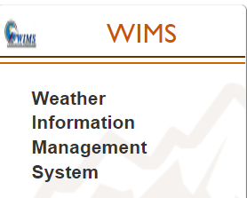
WIMS User Guide

Slide 2
Objectives
Log into WIMS via Wildland Fire Application Portal
Navigation Methods
Menus
FastPaths
What are FastPaths?
How FastPaths work?
Navigation Tree
Query Blocks
Editing/Displaying Observations and Station Data
Printing/Exporting Observations

Slide 3
Wildland Fire Application Portal
Web Address – https://iwfirp.nwcg.gov/index.html)
Where WIMS, and several other applications are located including IROC, SIT-209,etc
Wildland Fire Application Portal also used to access IROC (Interagency Resource Ordering Capability)

Slide 4
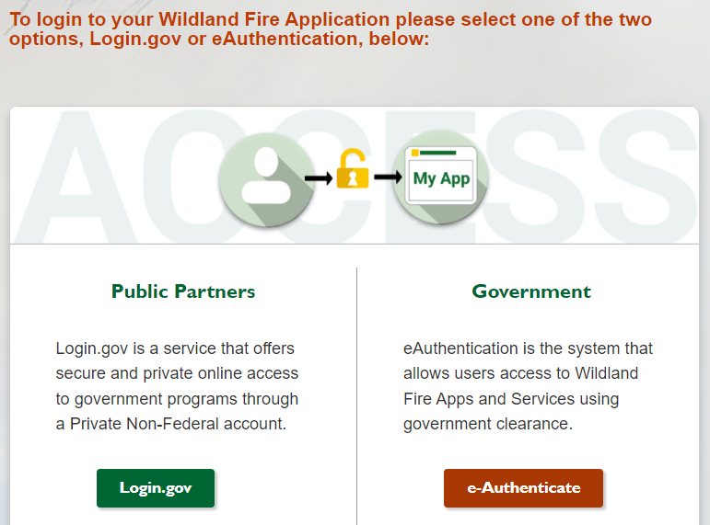
Wildland Fire Application Portal
Click on Login.gov for Non-Federal Users and e-Authenticate for Federal Users (Logs in using PIV Card) To log in using PIV Card you must be on a federal network or VPN)
Click on “Request User Account” if you need to obtain a NAP User Account
Notes:
Click on the FAMWEB Password management link to open the password change steps.

Slide 5
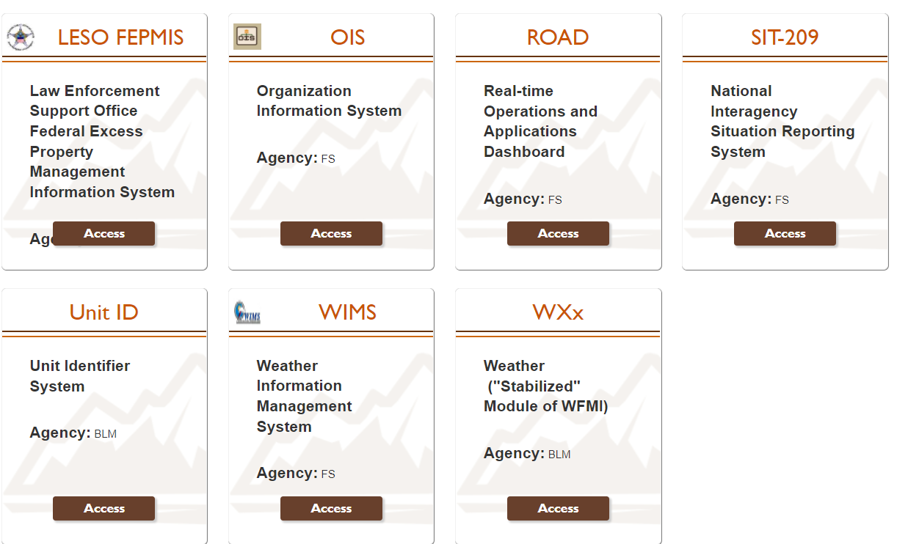
Click on Access to open WIMS interface
Notes:
Click on the FAMWEB Password management link to open the password change steps.

Slide 6
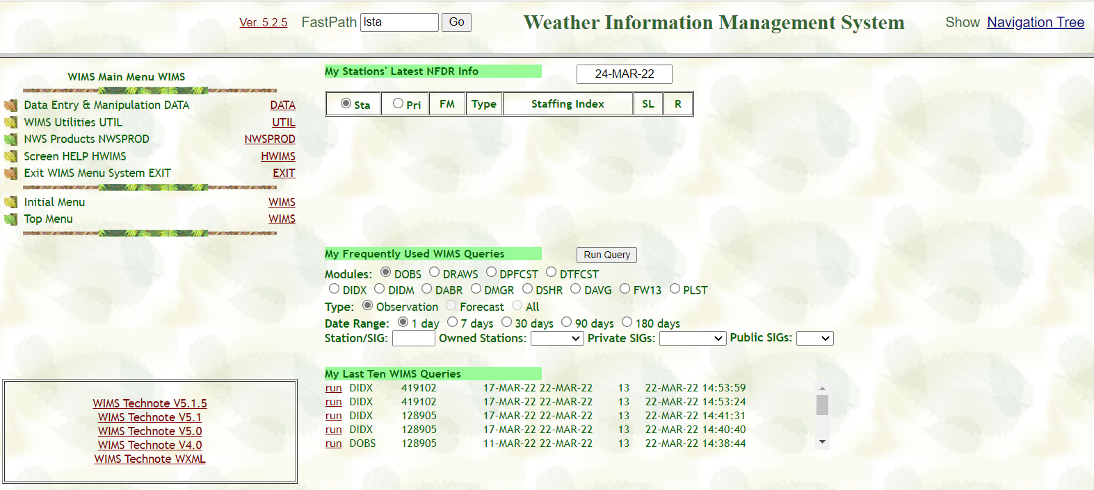
Navigating in WIMS
Clicking the links on Menus
FastPaths
Navigation Tree
Query Blocks

Slide 7
Fast Path entry
Link to Navigation
Tree
Initial Main Menu
Query
Requests
Notes:
Arrow 1 – denotes WIMS Main Menu – letting users know which menu is currently displayed.
Arrow 2 – displays the version of WIMS
Arrow 3 – displays all of the areas within WIMS – Data, Util, etc.
Arrow 4 – Displays the FastPath Box.
Arrow 5 – displays the link to the Navigation Tree

Slide 8
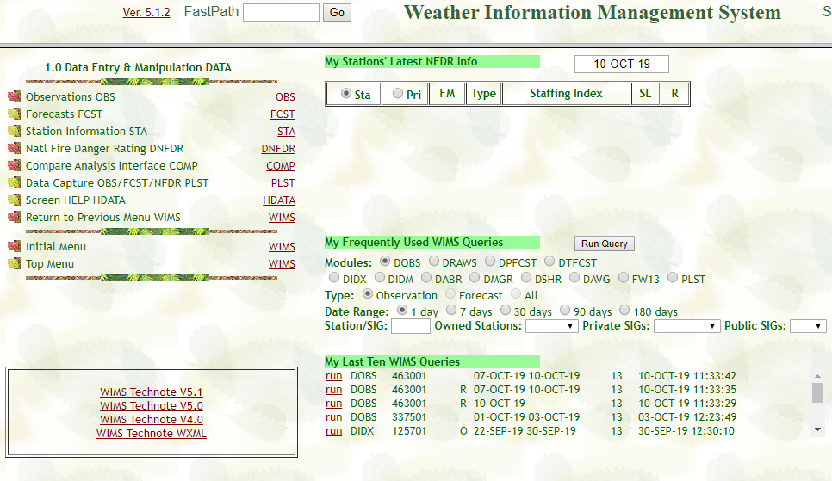
Common WIMS Fast Paths
Notes:
Arrow 1 – click on the links (ie OBS) to open the next menu or option.
Arrow 2 – returns the user to the Initial Menu or the WIMS main menu.

Slide 9
WIMS FastPaths
Quick links to WIMS tasks/commands
1st letter denotes action to be performed
D – Display
E – Edit
L – List
M – Maintain
N – New

Slide 10
Commonly Used FastPaths
DOBS – Display observations
EOBS – Edit Observations
ESTA – Edit Station
ENFDR – Edit NFDRS Parameters
ENRR – Recalculate NFDRS Indices
DRAWS – Display RAWS data
DIDX – Display NFDRS Indexes
DIDM – Display fuel moisture values
COMP-Compare NFDRS 78,88 to NFDRSv4 fuel models/indices
PLST-Download FW13 weather data for a RAWS or SIG (created group of RAWS)

Slide 11
Additional FastPaths
NACL- Create a new ACL or Access User Control List (add user(s) iNAP User IDs to this list for their access to a RAWS in WIMS for editing observations, station catlogs etc.)
LACL – List the users of an ACL group
EACL- Edit an ACL
NSIG – Create a new SIG (Special Interest Group or multiple RAWS)
LSIG – List the contents of a SIG group
ESIG – Edit a SIG
LUSER – List the users in WIMS
PROFILE - View and set profile defaults
EXIT – Log out of WIMS

Slide 12
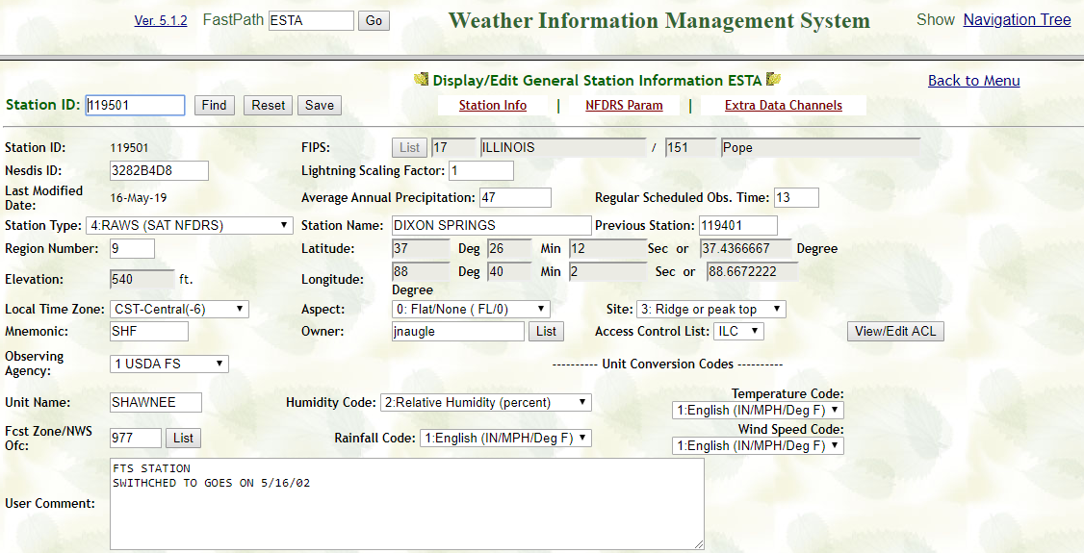
Navigation Tree

Slide 13
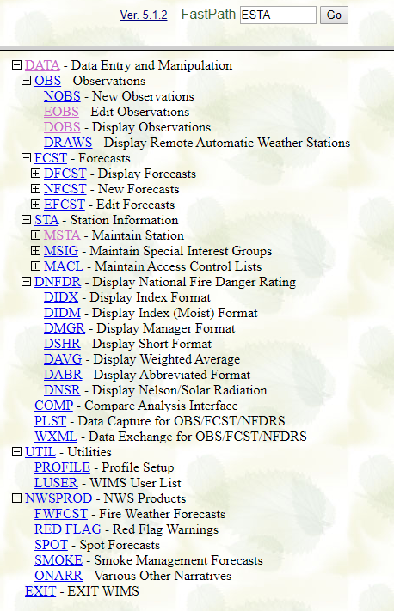
List of WIMS FastPaths
Navigation Tree
Displays FastPaths by area
Accessed by clicking on Navigation Tree link in upper right
Notes:
How does the user know what all of the FastPaths are? The Navigation Tree!

Slide 14
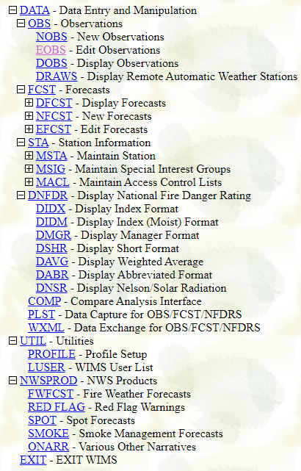
COMP relatively newer FastPath.
COMP is a tool used to compare 1978/88 Fuel Models with 2016 Fuel Model Indices/Fuel Moistures.
PLST is a tool used to output FW13 weather obs for RAWS or SIGS.
Notes:
The initial Navigation Tree display. By clicking on the “+” for an area, for instance DATA, the tree will expand.

Slide 15
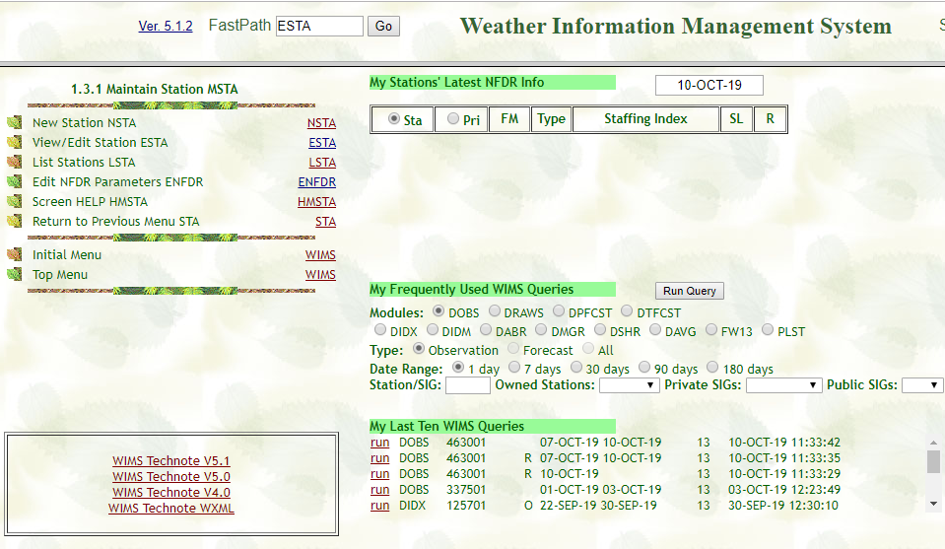
Enter Fast Path and click on “Go”

Slide 16
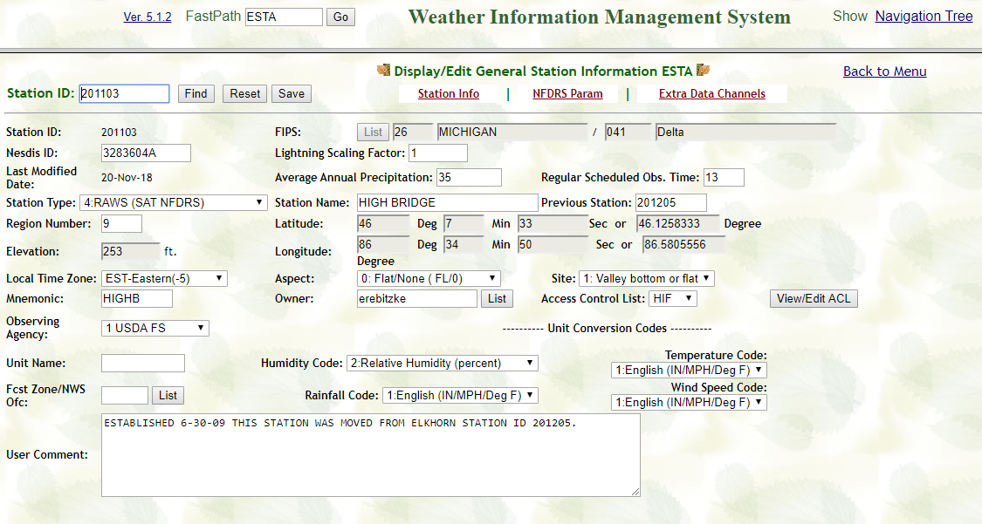
ESTA FastPath- Edit Station Data
Edit Station Data and then click on “Save”
NSTA is FastPath used for setting up a new RAWS
Notes:
After entering the FastPast ESTA and clicking GO, the Display/Edit General Station Information ESTA screen will open. The user needs to supply the Station ID and click Find.

Slide 17
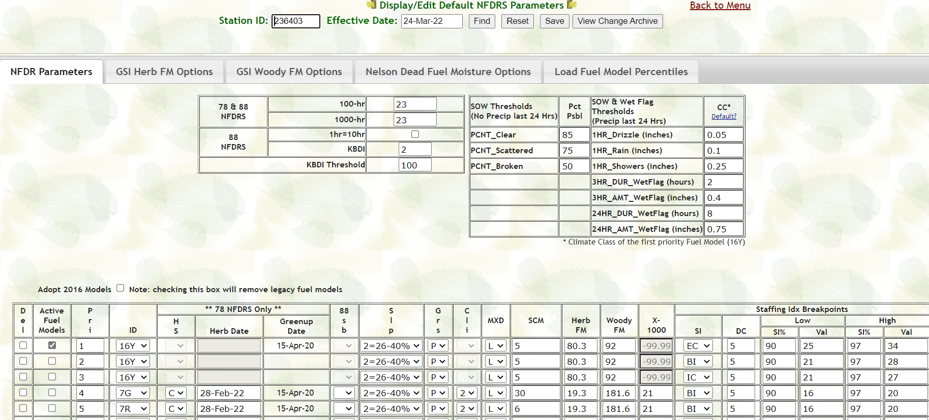
ENFDR FastPath-Display/Edit Default NFDRS Parameters
After making edits in the ENFDR FastPath for a station click on “Save” to store updated information.
Click on Fuel Models you wish to be Active.
Enter Staffing Indices, Decision Classes, and Percentiles and Breakpoints for each Active Fuel Model.
Notes:
After entering the FastPast ESTA and clicking GO, the Display/Edit General Station Information ESTA screen will open. The user needs to supply the Station ID and click Find.

Slide 18
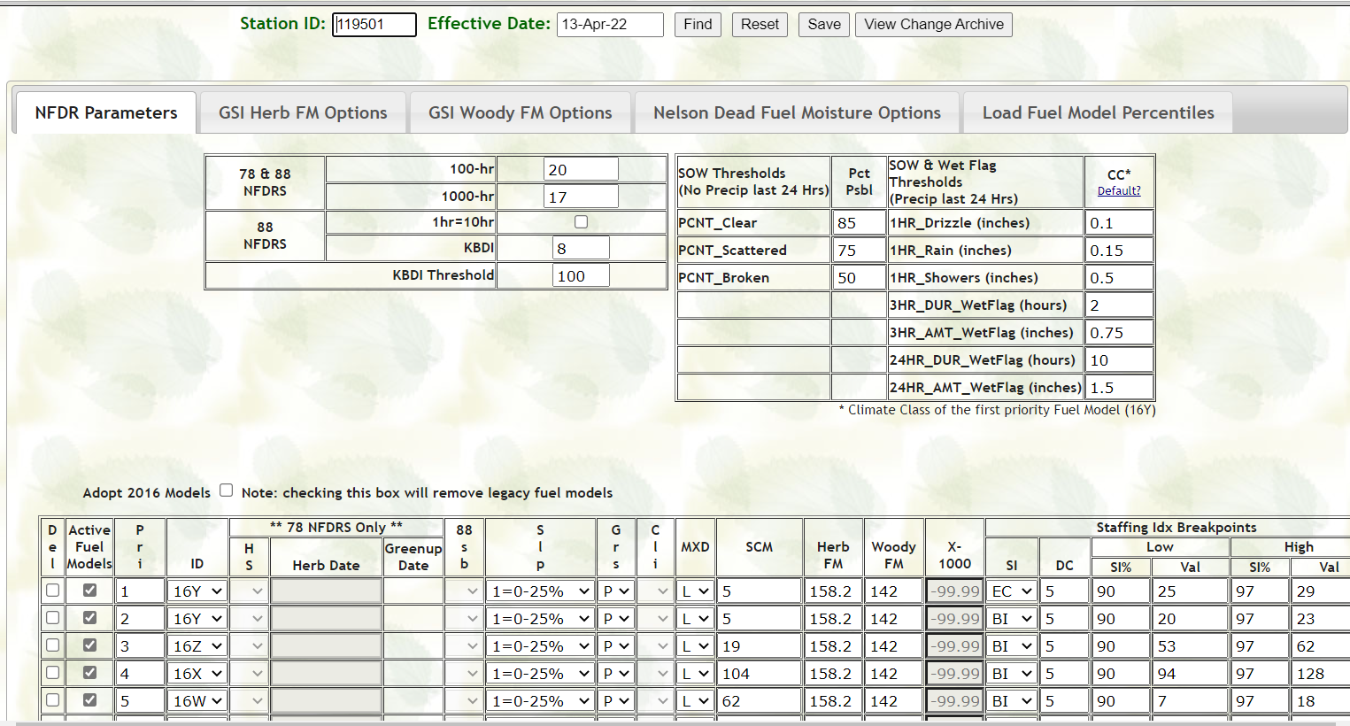
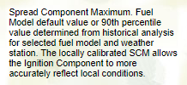
ENFDR FastPath- NFDRS Version 4 Parameters
For most RAWS in the Eastern Area the MXD should be left at “Low”. Some stations in more humid climates may use “H”.
The SCM is calculated automatically by WIMS but can be adjusted.
New parameters for the NFDRSv4 system.
Notes:
After entering the FastPast ESTA and clicking GO, the Display/Edit General Station Information ESTA screen will open. The user needs to supply the Station ID and click Find.

Slide 19
ENFDR FastPath- Adopting NFDRS Version 4 Fuel Models
To adopt the NFDRSv4 fuel models click this box and then click on “Save” at the top. It may take a day or two for the adoption of V4 fuels to occur
Once the adoption to Version 4 fuel models is complete, the legacy (1978/88) fuel models will be eliminated.
Check the boxes of the desired Version 4 fuel models which will be active in WIMS. 16Y should be one of them as this model is used for national fire danger/potential products.
Notes:
After entering the FastPast ESTA and clicking GO, the Display/Edit General Station Information ESTA screen will open. The user needs to supply the Station ID and click Find.

Slide 20
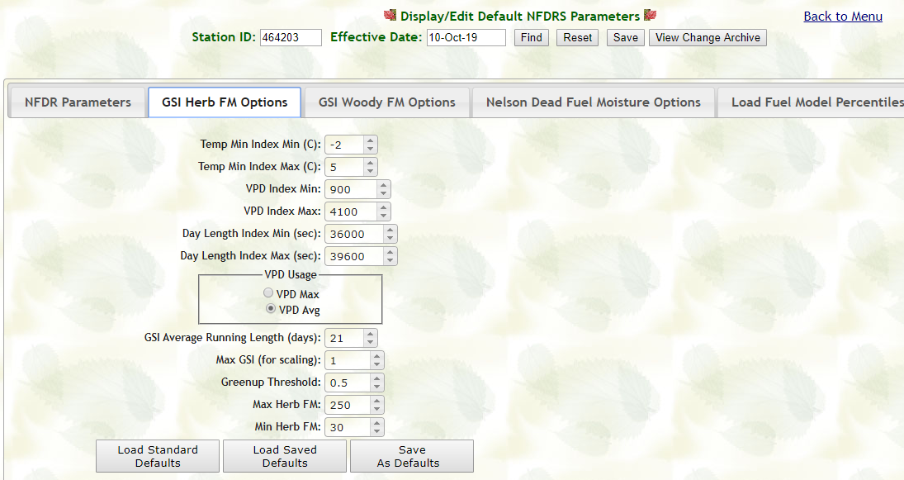
ENFDR -Display/Edit Growing Season Index/Nelson Fuel Moisture Options
After making edits in the ENFDR FastPath for a station click on “Save” to store updated information.
For most RAWS these GSI/Nelson Fuel Moisture options may be left at their default values/selections. However, if the calculated live fuel moistures appear inaccurate they may be adjusted.
Notes:
After entering the FastPast ESTA and clicking GO, the Display/Edit General Station Information ESTA screen will open. The user needs to supply the Station ID and click Find.

Slide 21
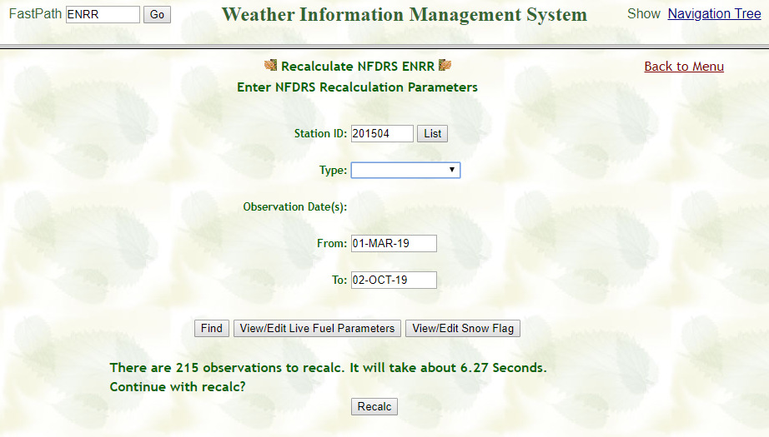
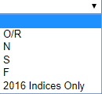
ENRR –Recalculate NFDRS Indices/Fuel Moistures after making changes in ENFDR or editing/entering weather obs
1. Enter RAWS WIMS ID.
2. Select Obs Type from dropdown. “Nelson” Recalcs should be done first, then “2016 Indices Only”.
4. Click “Find”
3. Select Date Range back to where updates/edits to weather obs or ENFDR data was entered.
4. Click “Recalc”
Notes:
After entering the FastPast ESTA and clicking GO, the Display/Edit General Station Information ESTA screen will open. The user needs to supply the Station ID and click Find.

Slide 22
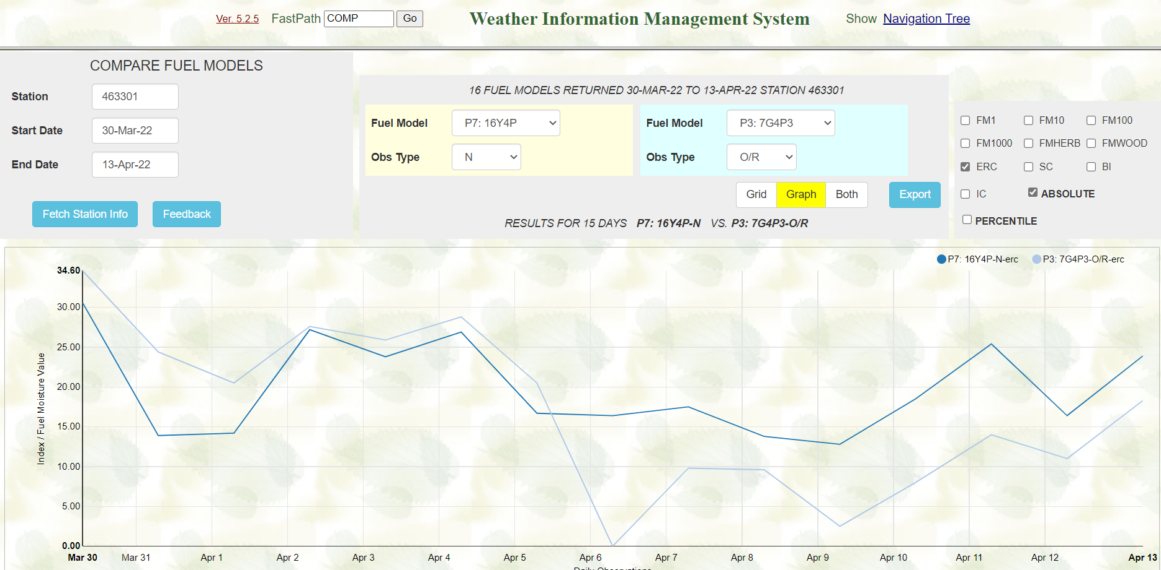
COMP FastPath– Compare 1978/88 to Version 4 Index/Fuel Moisture Outputs
Select Indices/Fuel Moistures to Compare
Select Fuel Models to Compare
Select “Grid, Graph, or Both” to Display and Compare
Select Absolute or Percentiles to Display

Slide 23
PLST FastPath-Data Capture and Output
Enter RAWS WIMS ID or SIG
Select Obs Type
Select Start/End Dates Using Calendar Dropdown
Select Export CSV or FW13 File Output for Download

Slide 24
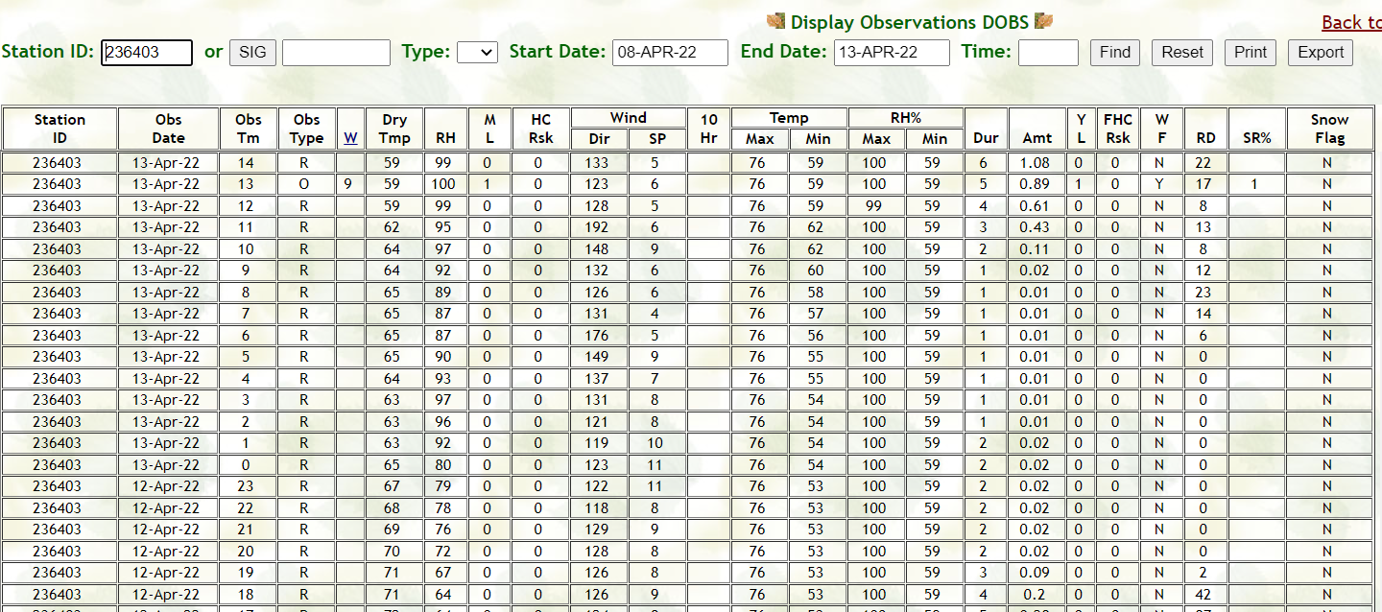
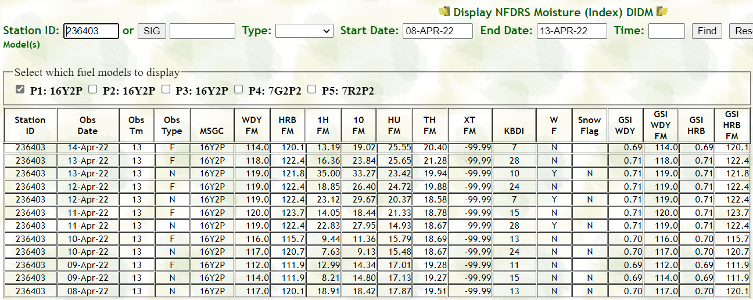
DOBS FastPath-Display Observations
DIDM FastPath– Display NFDRS Fuel Moistures

Slide 25
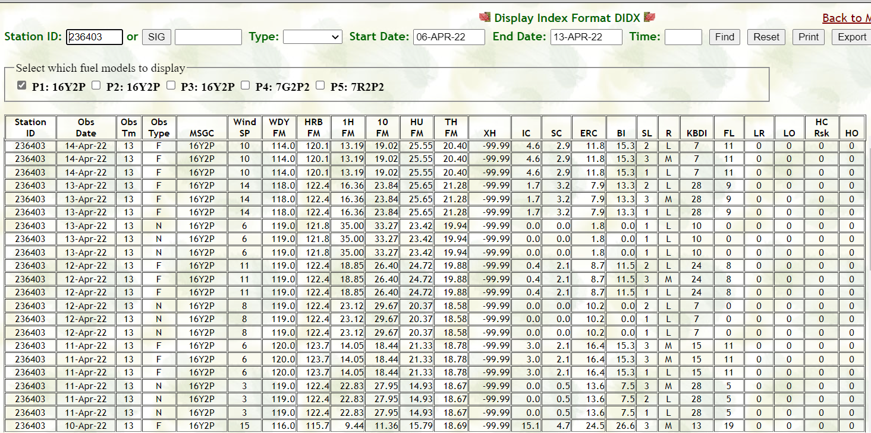
DIDX FastPath-Display NFDRS Index/Fuel Moisture Outputs
Click on Fuel Models you wish to view. Once NFDRSv4 breakpoints are entered in ENFDR page Staffing Level and Adjective Ratings will also be displayed.
Hover cursor over the top of each column to display explanation of content

Slide 26
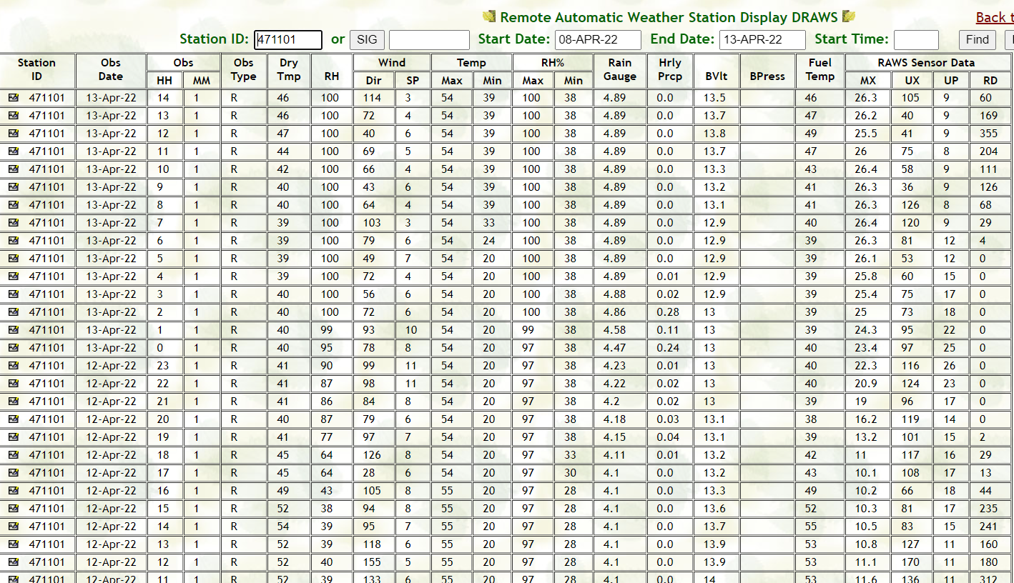
DRAW FastPath-Display “Raw” Weather Outputs
Hover cursor over the top of each column to display explanation of content

Slide 27
WIMS
Observation Inputs

Slide 28
Objectives
Edit observations
Snow Flag – Importance and how to manage
Missing Data – how to enter
Editing observations from DRAWS
Export/Print observations

Slide 29
Edit Observations
FastPaths
NOBS (New Observations)
EOBS (Edit Observations – Daily 1300 Obs R->O)

Slide 30
Entering/Edit Observations
Enter WIMDS ID or SIG, R for Ob Type, Date and 1300 for Time
Enter Date
Click “Find”
Enter WIMS ID or SIG (Group of
RAWS you can set up in WIMS)
Enter R for
raw ob type
Enter 13 for Time

Slide 31
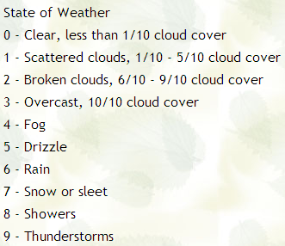
Click “Save”
Change R to O for Observed
Enter State of the Weather Code if still using/editing legacy fuel models models
Ensure other elements look accurate (Quality Control)
Wet and Snow Flags (Yes or No) See Next Slides
***For 1988 Fuel Models adjust the Grass and Shrub Greenness Factors from 1-20 when editing daily 1300 Obs. 1=Cured 20=Full Greenup.***

Slide 32
SNOW FLAG
Snow Flag (on or off) will still need to be manually edited for accurate fuel moisture and fire danger index calculations in NFDRS Version 4.
Use EOBS to turn the Snow Flag on or off in the far right column.
Snow Flag settings can be retroactively edited using the Recalc WIMS FastPath Interface (ENRR).
A Recalc of indices is required after making retroactive Snow Flag edits (“N” or Nelson and then “2016 Indices Only”).

Slide 33
Editing Snow Flags using EOBS FastPath
Turn the Snow Flag on or off by entering Y or N. Then click on “Save/Publish”. The off or on will then carry forward in subsequent hourly observations until you edit the Snow Flag again.

Slide 34
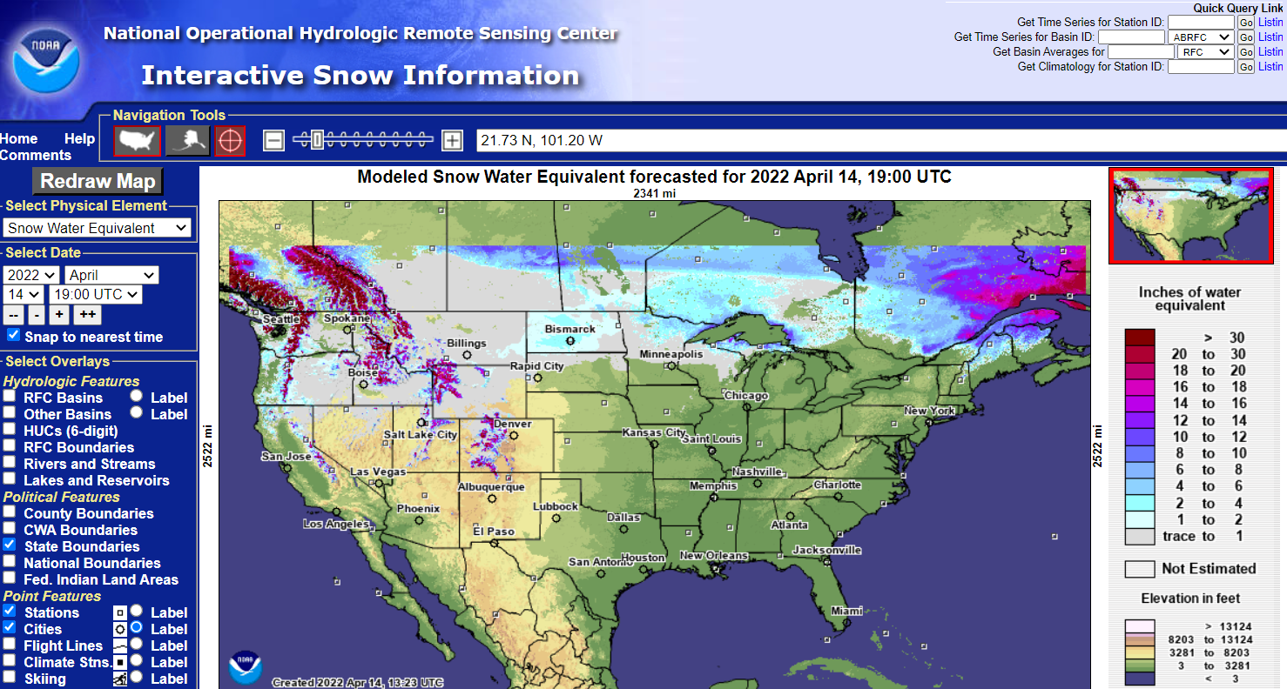
Using NOAA Interactive Snow Website to Estimate Past Snow on/off Dates
https://www.nohrsc.noaa.gov/interactive/html/map.html
Enter Station ID (Not the WIMS ID) in the “Get Time Series for Station ID” box, and then Click on “Go” to go to snow data graphs for the RAWS of concern.
The next slide demonstrates how to obtain the RAWS Station ID.
“Get Time Series for Station ID”,
“Get Time Series for Station ID”,
“Get Time Series for Station ID”,

Slide 35
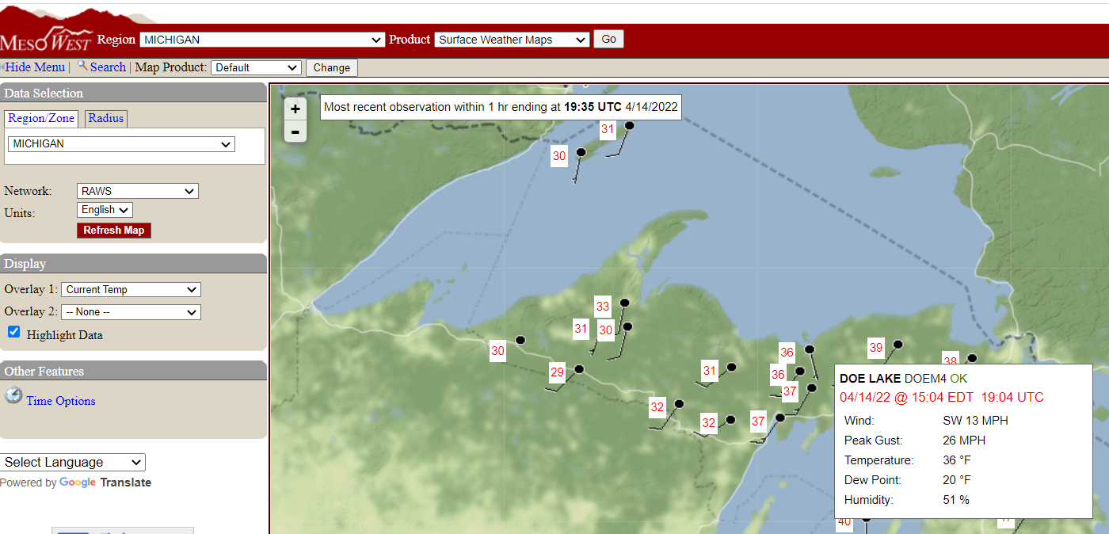
Using MesoWest to Obtain a RAWS Station ID
https://mesowest.utah.edu/
“Get Time Series for Station ID”,
“Get Time Series for Station ID”,
“Get Time Series for Station ID”,
Click on the state where the RAWS of concern is located.
Select “RAWS” and “Refresh Map” to view RAWS on map.
Click on the RAWS you wish to view the five character Station ID.

Slide 36
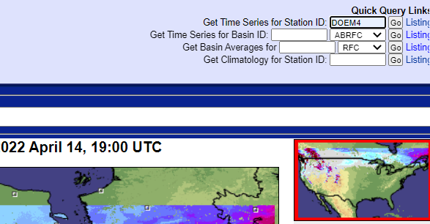
Using NOAA Interactive Snow Website to Estimate Past Snow on/off Dates
https://www.nohrsc.noaa.gov/interactive/html/map.html
“Get Time Series for Station ID”,
“Get Time Series for Station ID”,
“Get Time Series for Station ID”,
Enter Station ID (Not the WIMS ID) in the “Get Time Series for Station ID” box, and then click on “Go” to go to snow data for the RAWS of concern.

Slide 37
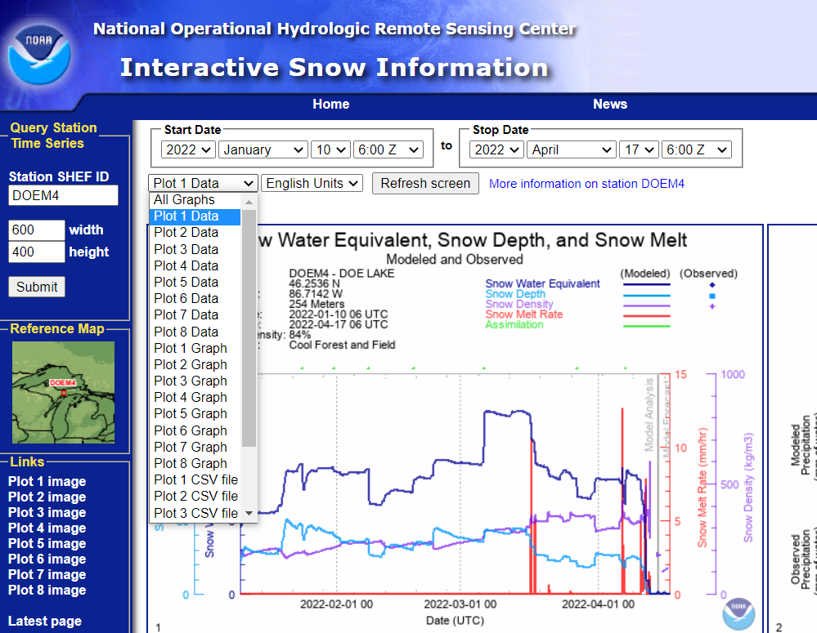
Using NOAA Interactive Snow Website to Estimate Past Snow on/off Dates
https://www.nohrsc.noaa.gov/interactive/html/map.html
“Get Time Series for Station ID”,
“Get Time Series for Station ID”,
“Get Time Series for Station ID”,
Select the date range of concern.
Select “English Units”
Then select Plot 1 Data rom the dropdown and click on “Refresh Screen”.

Slide 38
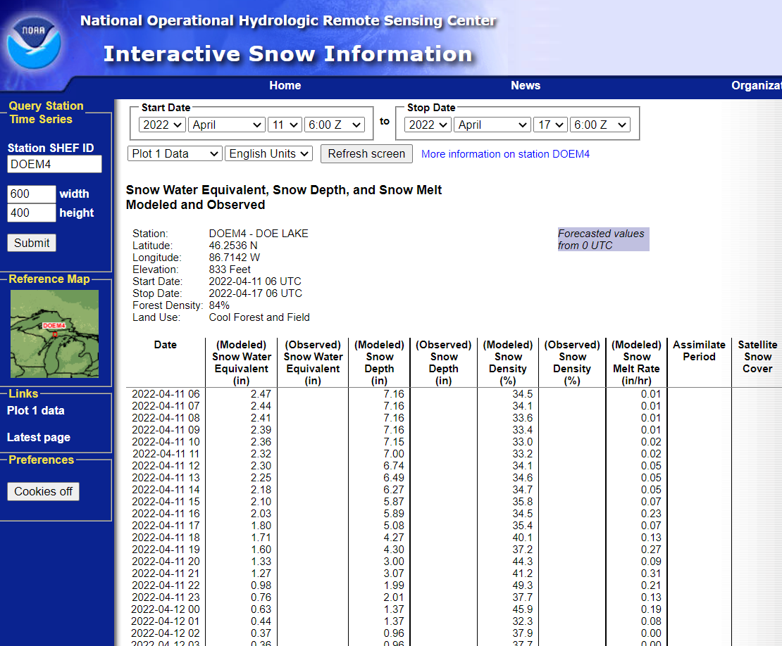
Using NOAA Interactive Snow Website to Estimate Past Snow on/off Dates
https://www.nohrsc.noaa.gov/interactive/html/map.html
Take note of the modeled snow depths for each day through the selected date range.
This data can then be used to edit the Snow Flags for a RAWS using the ENRR WIMS FastPath.

Slide 39
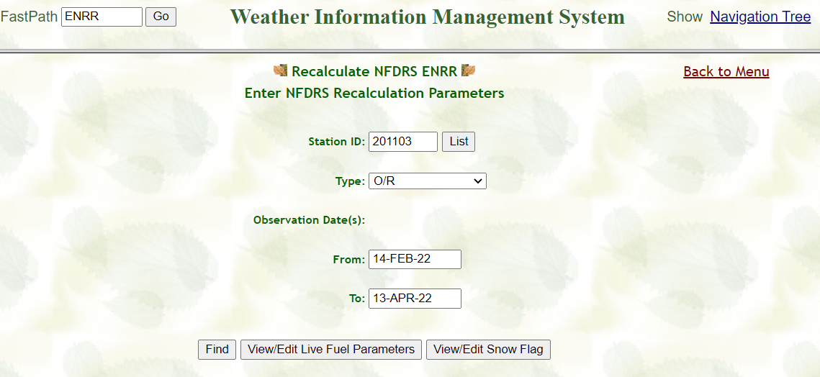
Editing Snow Flags retroactively using the ENRR FastPath
Enter the RAWS WIMS ID you edit, a 90 Day date range, and click on View/Edit Snow Flag.

Slide 40
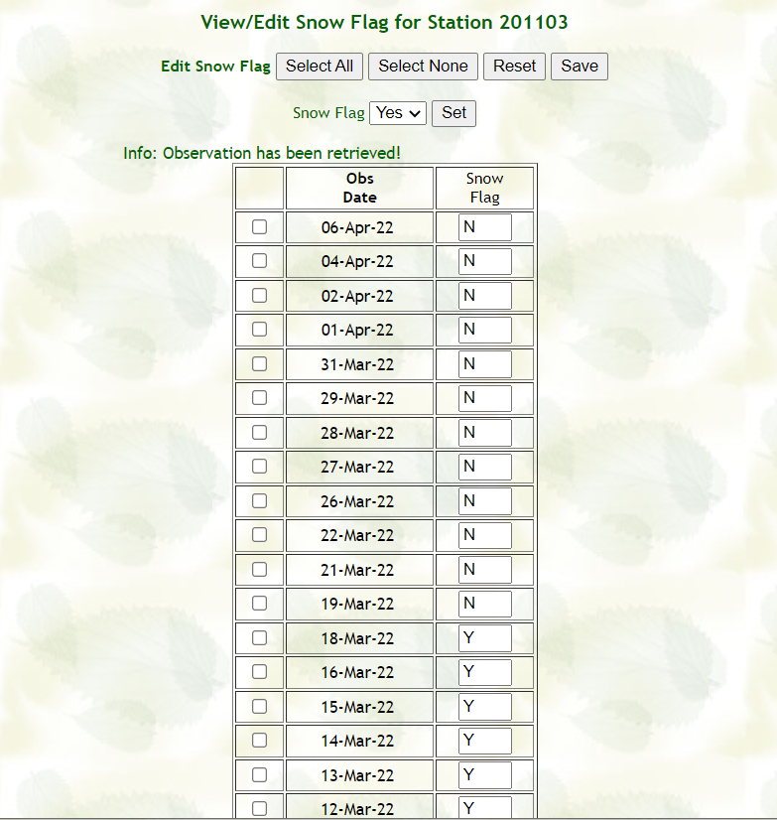
Editing Snow Flags retroactively using the ENRR FastPath
Manually enter Y (Snow Flag on) or N (Snow Flag off) or use the options at the top to select the dates you wish to edit the Snow Flag settings.
Click on “Save” to enable the edits.
When the Snow Flag is Yes:
Sets Air Temperature to 32°F / 0°C
Sets Relative Humidity to 99.99%
Sets Solar Radiation to 0
Previous day’s Precipitation Amount is carried forward

Slide 41
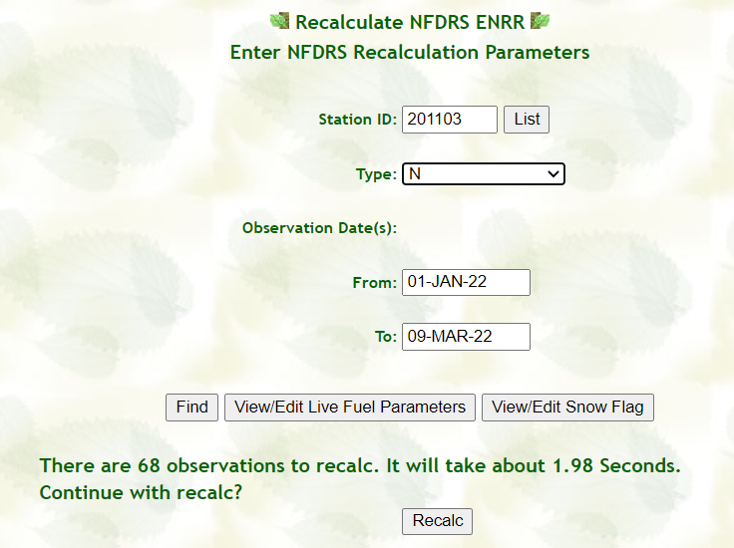
Recalculating NFDRSv4 Indices after editing Snow Flag Data using the ENRR FastPath
Enter the RAWS WIMS ID.
Select “N” to recalculate the Nelson dead fuel moistures first.
Click on “Find”
WIMS will display how many observations will be recalculated.
Then Click on Recalc button at the bottom

Slide 42
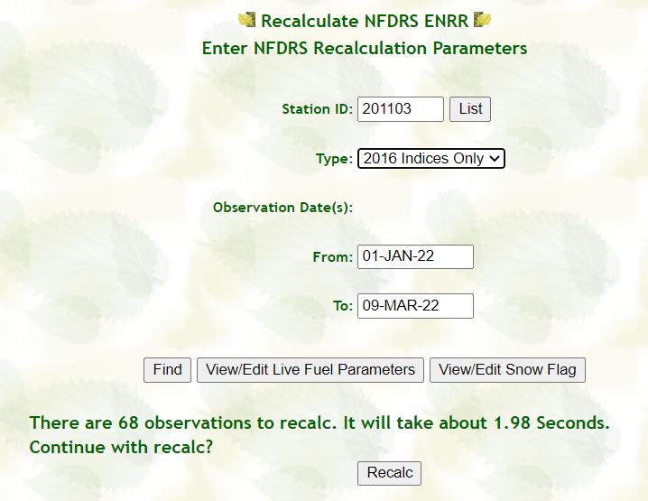
Recalculating NFDRSv4 Indices after editing Snow Flag Data using the ENRR FastPath
Enter the RAWS WIMS ID.
Select “2016 Indices Only” to recalculate the NFDRSv4 indices second.
Click on “Find”
WIMS will display how many observations will be recalculated.
Then Click on Recalc button at the bottom

Slide 43
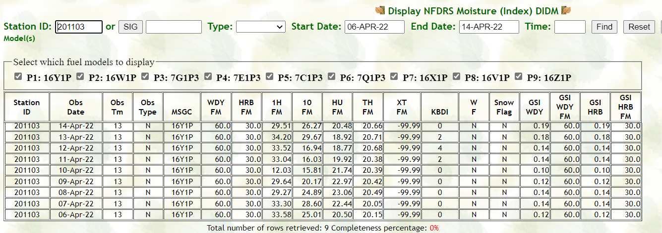
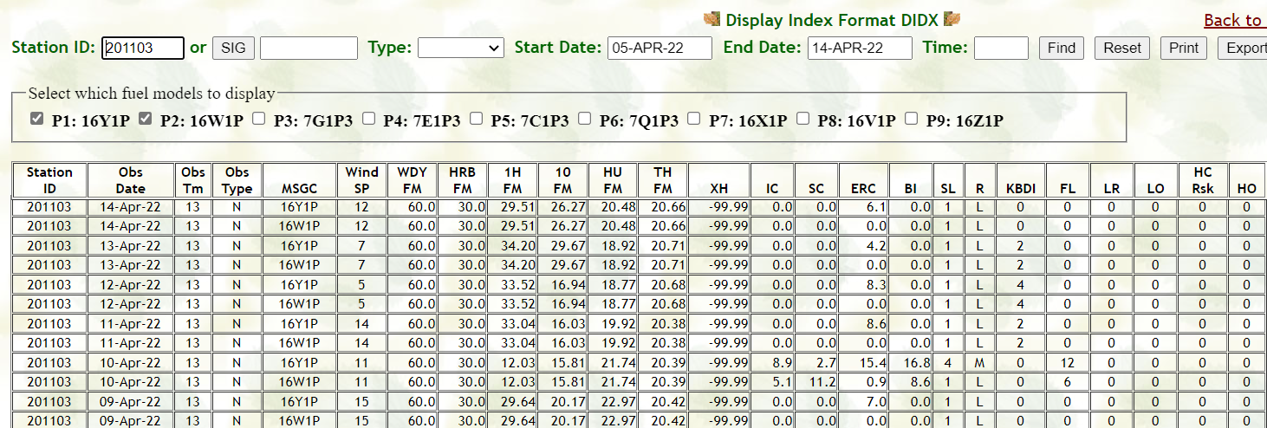
Checking Results of Recalculations using the DIDM/DIDX WIMS FastPaths
DIDM - Recalculated Fuel Moistures
DIDX - Recalculated NFDRSv4 Indices

Slide 44
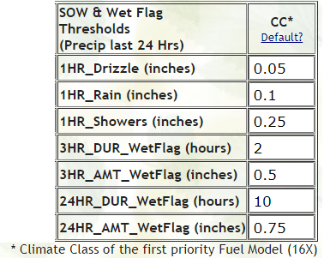
WET FLAG
Flag in the observation that notes the fuels are wet.
The State of the Weather will set the Wet Flag to Y or N.
The Wet Flag can be forced to Y even if the State of the Weather keeps Wet Flag set to N.
Setting the WF to Y will drive up the 1000hr and therefore effect live fuel moistures.
The parameters for a Wet Flag can be modified on the ESTA page in the NFDRS section where the precipitation amounts and duration time can be changed. Default settings are based on the selected climate class of the station.

Slide 45
Print/Export Observations
Print – creates a file formatted for printing
Export – creates a comma delimited file
Maybe imported into spreadsheets, etc.

Slide 46
Print/Export Obs
Print
Export

Slide 47
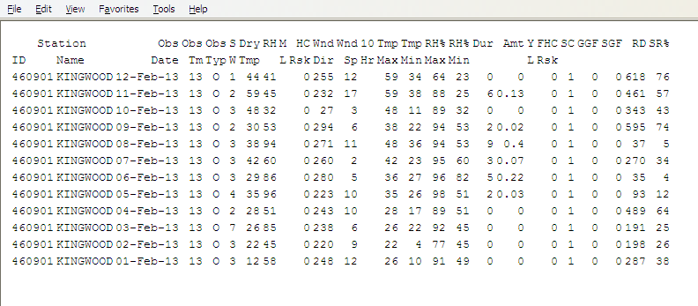
Print Output

Slide 48
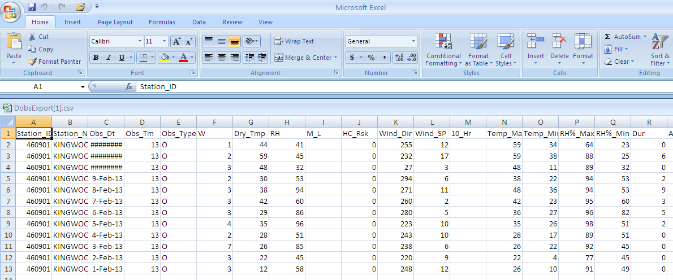
Export Output (Excel File)

Slide 49
Questions/Comments? Please send to Steve Marien at: stephen_marien@nps.gov

